Slide 1



PERANCANGAN VLAN SERTA TRUNKING PADA JARINGAN PT. CITRA MANDIRI NEGARA DENGAN MENERAPKAN ROUTING OSPF
411221012 – KENEDI PERES
Fakultas :
Teknik
Program Studi:
Informatika

Slide 2
Latar Belakang
Mengoptimalkan dan membuat route komunikasi antar divisi Prepress, divisi produksi CPI ( Mesin Digital Print & Mesin Cutting ) dan Divisi Produksi CFI ( CTP).

Slide 3
Rumusan Masalah
Bagaimana membuat jalur komunikasi data antara kantor pusat dan kantor cabang ?
Bagaimana mengoptimalkan protokol jaringan untuk stabilitas ?

Slide 4
Tujuan dan Manfaat
Tujuan
Segmentasi VLAN berdasarkan divisi.
Penerapan ACL untuk mengisolasi VLAN tertentu.
Manfaat
Efisiensi komunikasi antar divisi.
Penyimpanan data terpusat.
Pengurangan biaya operasional.

Slide 5
Metodologi Penelitian
Jenis Penelitian yaitu Penelitian Terapan
Metode Pengumpulan Data:
Observasi topologi eksisting.
Studi literatur (VLAN, OSPF, ACL, STP, Etherchannel, dan LAN Security.).
Analisis Kebutuhan
Segmentasi VLAN
Routing OSPF

Slide 6
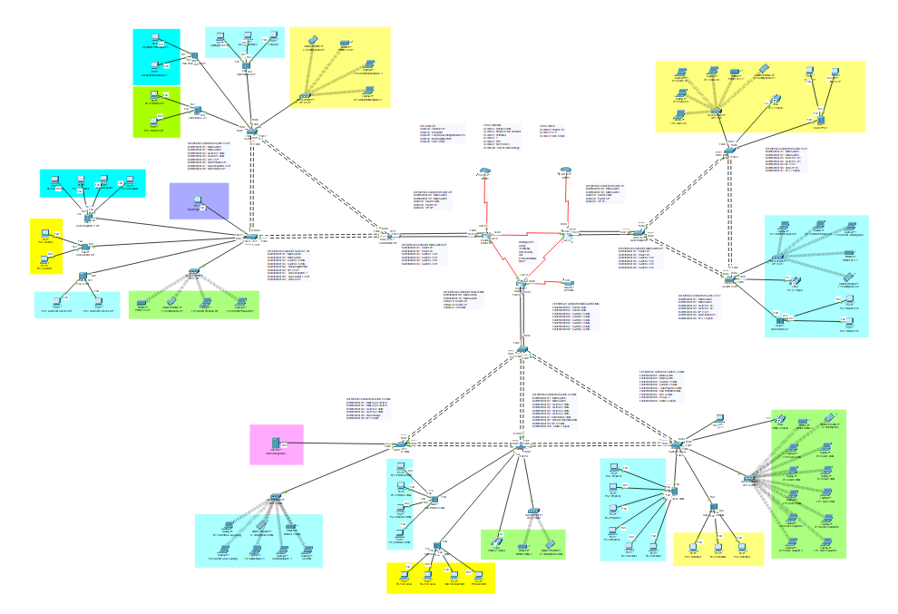
Design Topologi Jaringan

Slide 7
Design Topologi Jaringan
PT. Citra Mandiri Negara (Area 0), PT. Citra Print Indonesia (Area 1), dan PT. Citra Factory Indonesia (Area 2).
Protokol Jaringan
Routing OSPF
VLAN
STP
ACL
LAN Security
Etherchannel
DHCPv4

Slide 8
Implementasi VLAN dan Subnetting
PT. Citra Mandiri Negara
ID VLAN | Nama VLAN | Subnet/IP Address | Gateway
10 | Finance CMN | 192.168.10.0/24 | 192.168.10.1
15 | Prepress & Desainer | 192.168.15.0/24 | 192.168.15.1
20 | Estimator | 192.168.20.0/24 | 192.168.20.1
25 | Spv IT | 192.168.25.0/24 | 192.168.25.1
30 | PPIC | 192.168.30.0/24 | 192.168.30.1
35 | Staff Umum | 192.168.35.0/24 | 192.168.35.1
100 | Data Storage (NAS) | 192.168.100.0/24 | 192.168.100.1

Slide 9
Implementasi VLAN dan Subnetting
PT. Citra Print Indonesia
ID VLAN | Nama VLAN | Subnet/IP Address | Gateway
40 | Finance CMN | 192.168.40.0/24 | 192.168.40.1
45 | Prepress & Desainer | 192.168.45.0/24 | 192.168.45.1
50 | Estimator | 192.168.50.0/24 | 192.168.50.1
55 | Spv IT | 192.168.55.0/24 | 192.168.55.1
60 | PPIC | 192.168.60.0/24 | 192.168.60.1

Slide 10
Implementasi VLAN dan Subnetting
PT. Citra Factory Indonesia
ID VLAN | Nama VLAN | Subnet/IP Address | Gateway
65 | Finance CPI | 192.168.65.0/24 | 192.168.65.1
70 | Mesin CTP | 192.168.70.0/24 | 192.168.70.1
75 | Staff Umum | 192.168.75.0/24 | 192.168.75.1

Slide 11
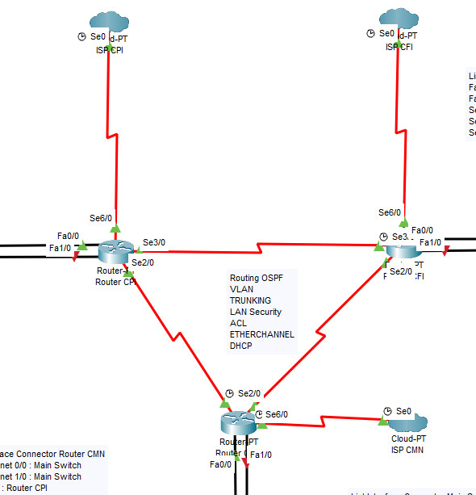
Implementasi OSPF
Router CMN
router ospf 1
router-id 1.1.1.1
network 192.168.15.0 0.0.0.255 area 0
network 192.168.25.0 0.0.0.255 area 0
network 192.168.100.0 0.0.0.255 area 0
network 10.0.0.0 0.0.0.3 area 0
network 10.0.0.4 0.0.0.3 area 0

Slide 12
Implementasi OSPF
Router CPI
router ospf 1
router-id 2.2.2.2
network 192.168.45.0 0.0.0.255 area 1
network 192.168.50.0 0.0.0.255 area 1
network 192.168.55.0 0.0.0.255 area 1
network 10.0.0.0 0.0.0.3 area 0
network 10.0.0.8 0.0.0.3 area 1

Slide 13
Implementasi OSPF
Router CFI
router ospf 1
router-id 3.3.3.3
network 192.168.70.0 0.0.0.255 area 2
network 10.0.0.4 0.0.0.3 area 0
network 10.0.0.8 0.0.0.3 area 2

Slide 14
Hasil Pengujian
Hasil Pengujian dari VLAN 15 ( Prepress ) ke VLAN 70 ( CTP ) Pinging 192.168.70.2 with 32 bytes of data:
Reply from 192.168.70.2: bytes=32 time=1ms TTL=126
Reply from 192.168.70.2: bytes=32 time=12ms TTL=126
Reply from 192.168.70.2: bytes=32 time=10ms TTL=126
Reply from 192.168.70.2: bytes=32 time=22ms TTL=126
Ping statistics for 192.168.70.2:
Packets: Sent = 4, Received = 4, Lost = 0 (0% loss),
Approximate round trip times in milli-seconds:
Minimum = 1ms, Maximum = 22ms, Average = 11ms

Slide 15
Hasil Pengujian
Hasil Pengujian dari VLAN 15 ( Prepress ) ke VLAN 100 ( Data Storage ) Pinging 192.168.100.2 with 32 bytes of data:
Reply from 192.168.100.2: bytes=32 time<1ms TTL=127
Reply from 192.168.100.2: bytes=32 time<1ms TTL=127
Reply from 192.168.100.2: bytes=32 time=10ms TTL=127
Reply from 192.168.100.2: bytes=32 time<1ms TTL=127
Ping statistics for 192.168.100.2:
Packets: Sent = 4, Received = 4, Lost = 0 (0% loss),
Approximate round trip times in milli-seconds:
Minimum = 0ms, Maximum = 10ms, Average = 2ms

Slide 16
Hasil Pengujian
Hasil Pengujian dari VLAN 15 ( Prepress ) ke VLAN 40 ( Staff_Umum ) Pinging 192.168.60.2 with 32 bytes of data:
Reply from 192.168.40.1: Destination host unreachable.
Reply from 192.168.40.1: Destination host unreachable.
Reply from 192.168.40.1: Destination host unreachable.
Reply from 192.168.40.1: Destination host unreachable.
Ping statistics for 192.168.60.2:
Packets: Sent = 4, Received = 0, Lost = 4 (100% loss),

Slide 17
Kesimpulan
Segmentasi VLAN berdasarkan divisi, seperti VLAN Prepress, VLAN Mesin Digital Print dan VLAN CTP. Berhasil mengoptimalkan lalu lintas dalam transferring data, dan mempercepat komunikasi antar divisi dan kantor cabang.
Implementasi Access Control List (ACL) dan fitur keamanan LAN seperti Port Security berhasil mengisolasi lalu lintas sensitif VLAN Finance dan VLAN Staff Umum sekaligus memungkinkan akses terkontrol antar divisi yang membutuhkan, contohnya VLAN 15 ke VLAN 100 untuk penyimpanan terpusat.

Slide 18
Saran
Perlu pengadaan Router tambahan untuk mengoptimalkan routing antar VLAN dan NAS guna mendukung penyimpanan terpusat serta transfer file berukuran besar (>300MB) secara efisien.

Slide 19
Referensi
Cisco. (2022). OSPF Design Guide.
Ar-Rasyid, H. (2024). Optimasi VLAN Trunking.
Laksono, A. T. (2020). Implementasi ACL.

Slide 20


Bersinar
Bersama Undira
UNDIRA mengajak Anda untuk temukan jalanmu
untuk mencapai cita-cita, dan bersinar lebih terang menuju masa depan yang lebih cerah.

Slide 21

TERIMA KASIH

